Slide 1
Georgia Pacific
XIN XIONG

Slide 2
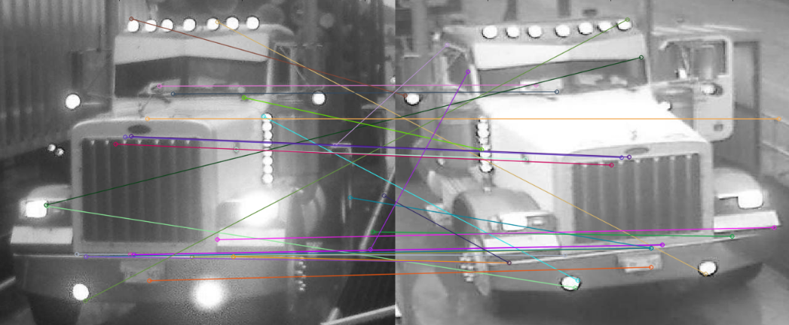
Brute Force

Slide 3
Brute Force contd..
When trucks are same – matching features – 28
When trucks are different – matching features are - 17

Slide 4
Comparing Two images
Using SSIM (Structural similarity measure) function in Scikit Learn to measure the similarity between two images.
Also implementing MSE algorithm
for similar images(before cropping) matching SSIM is 0.42
for similar images(after cropping) matching SSIM is 0.43
for different images (before cropping) matching SSIM is 0.40
for different images (after cropping) matching SSIM is 0.36

Slide 5
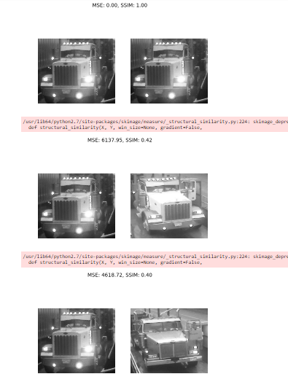

Slide 6
Thank You

